Slide 1
Relationship Drawing Rules
Rule number 1 – Determining which entities have relationships
Examine all the entities with single attribute primary keys
If you see another entity with a column the same name as the primary key…
Then you draw a one to many relationship between them
Rule number 2 – Determining which side gets the “many” end (part 1)
If you have a relationship between an entity with a primary key and an entity with a composite key then
The composite key entity always has the many end

Slide 2
Relationship Drawing Rules
Rule number 3 – Determining which side gets the “many” end (part 2)
Alternatively,
If you have a relationship between an entity with a primary key and an entity with a foreign key then
The foreign key entity always has the many end
Rule number 4 – Just in case…
Never draw a relationship between a composite key entity and a foreign key entity (even if they have the same column name)
Rule 1 tells you not to do this!

Slide 3
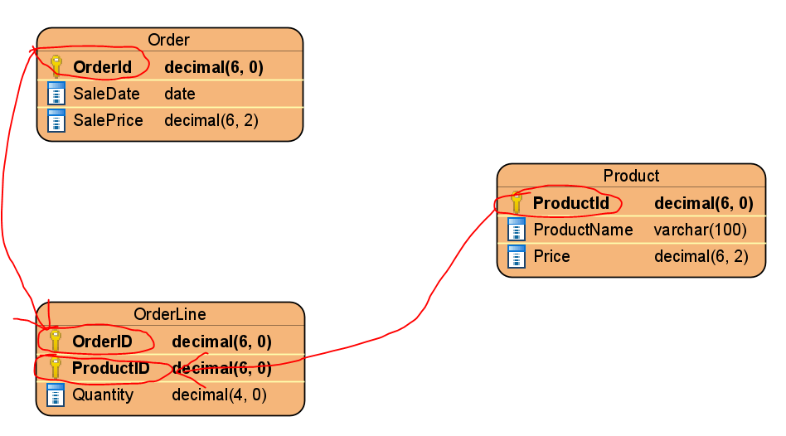
Rule 1 - Examples

Slide 4
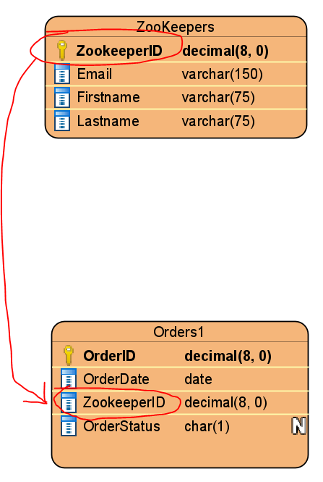
Rule 1 - Examples

Slide 5
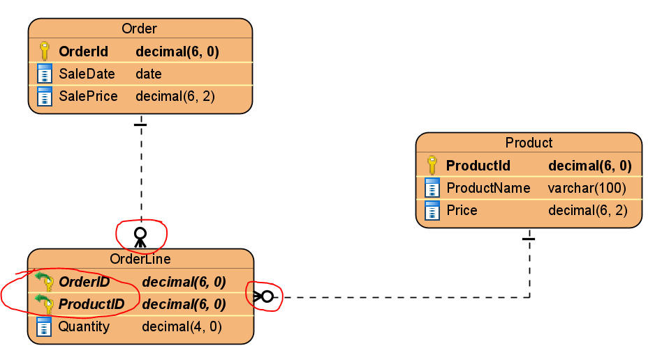
Rule 2 - Examples

Slide 6
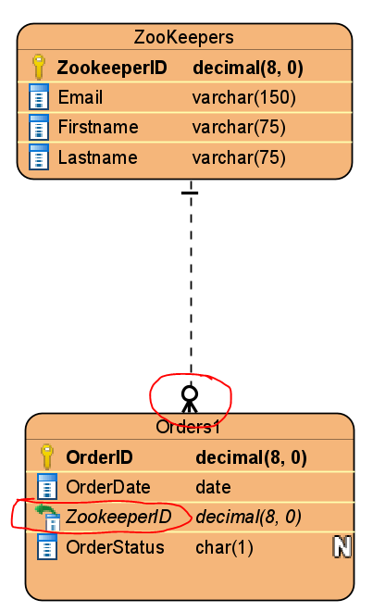
Rule 3 - Examples

Slide 7

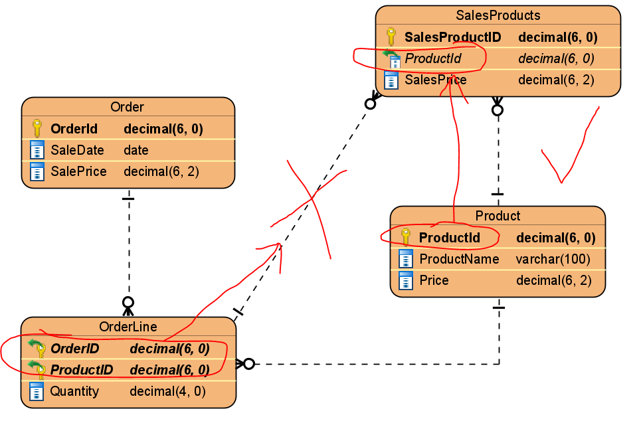
Rule 4 - Examples

